Slide 1

Applications of GIS
Week 11
Some more demonstrations
Q&A for A4

Slide 2
What are we going this week
Looking at elements at risk, vulnerability
How to present risk for each of these
Making some maps, how will they fit into your report?
Q&A

Slide 3
Vulnerability maps
You can create your vulnerability maps using two different methods. Those are:
Create separate vulnerability maps and combine them into one vulnerability map (possibly weighted), like you did with your hazard maps. Your risk map would therefore be your hazard x vulnerability map.
Risk equation = Hazard x Vulnerability x (4 elements at risk maps)
Create your vulnerability maps based on the four requirements used in your analysis (population, environment, industry and infrastructure). You would need to create four maps and your vulnerability would be related to each of these categories. Then, create a combined vulnerability and elements at risk map for each of the four requirements.
Risk equation = Hazard x (4 Vulnerability x elements at risk maps)

Slide 4
Vulnerability maps examples
There is a large list of data that you can use for your vulnerability maps and you are advised to do some research, but here are some examples:
Population density
Census data from Assignment 2 will be used to calculate this.
Follow the steps from the census assignment and calculate a population density field
Population density = Total People/ Area
Age distribution
Younger or elderly people may be more likely to be affected e.g. cannot drive.
Use census data again and calculate a vulnerability age group based on age distribution to map out
Distance to hospitals, distance to emergency facilities
Euclidean distance tool as demonstrated last week

Slide 5
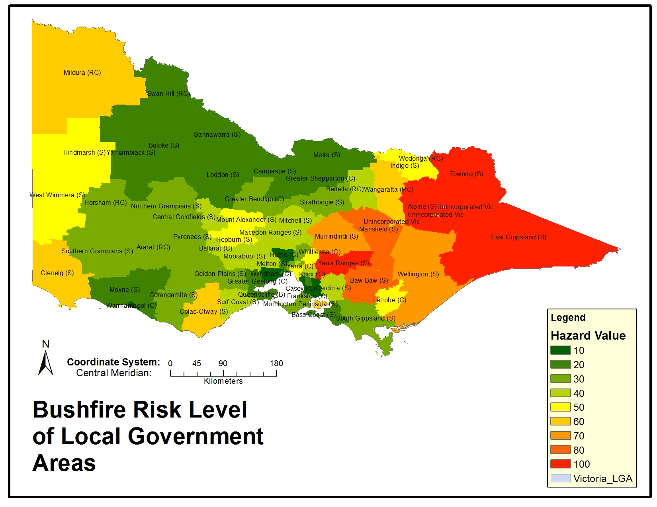
Elements at Risk and Vulnerability: Some Bushfire Examples
Constraint | Process | Potential Vulnerability Value
Hospital Points | Extract Values to Points | Number of Patients
Agriculture Polygons | Zonal Statistics Tool / Extract by Mask | Production Type
Fire Infrastructure | Extract Values to Points | Building Material
Environmental Conservation | Zonal Statistics Tool / / Extract by Mask | Flora / Fauna Endangered Rating
Population (By SA2 Region) | Zonal Statistics Tool | Age, Population Density, Disability

Slide 6
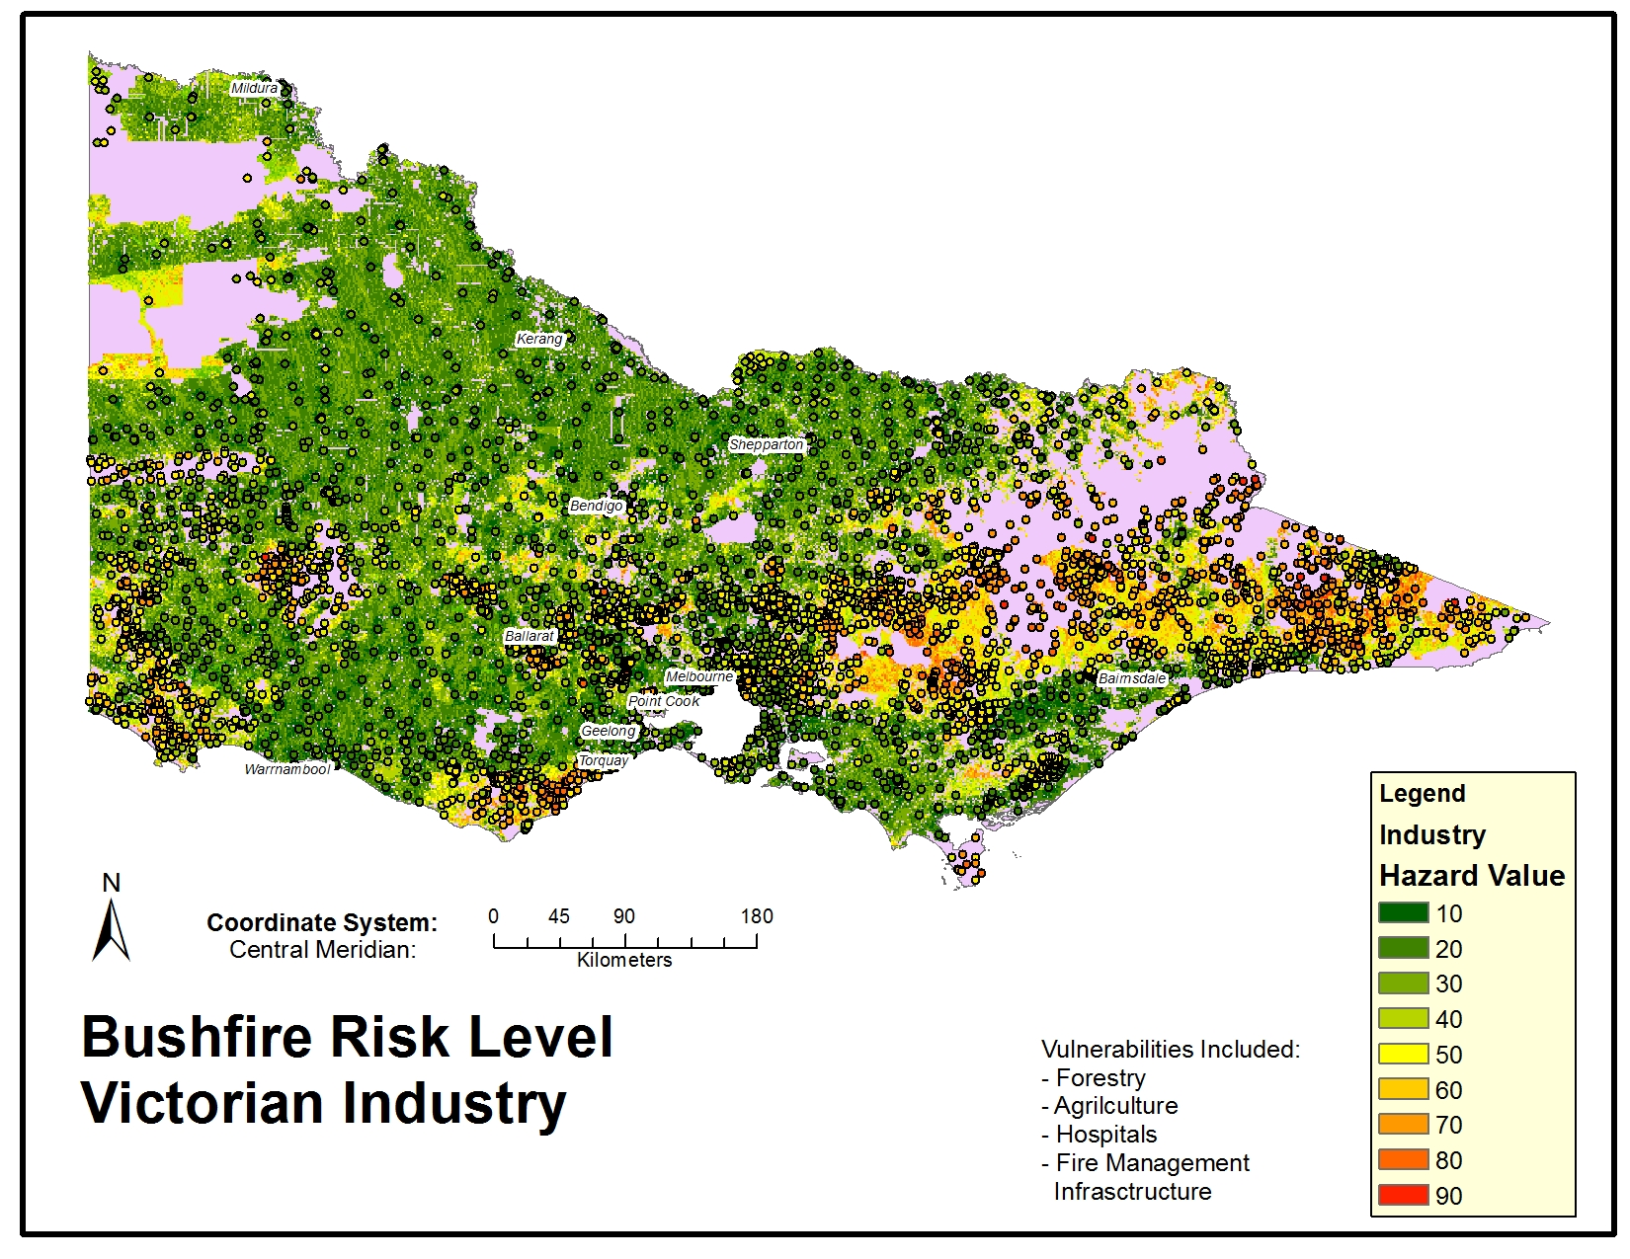
Elements at risk maps
Elements at risk can be categorized to your four requirements:
Industry
Population
Environment
Infrastructure
You need to have examples of all four.
It is recommended to create maps for each separate element at risk to be able to know the risk of each one. You can create a combined map at the end if you want.
E.g. Infrastructure – risk map for roads, train stations etc.

Slide 7
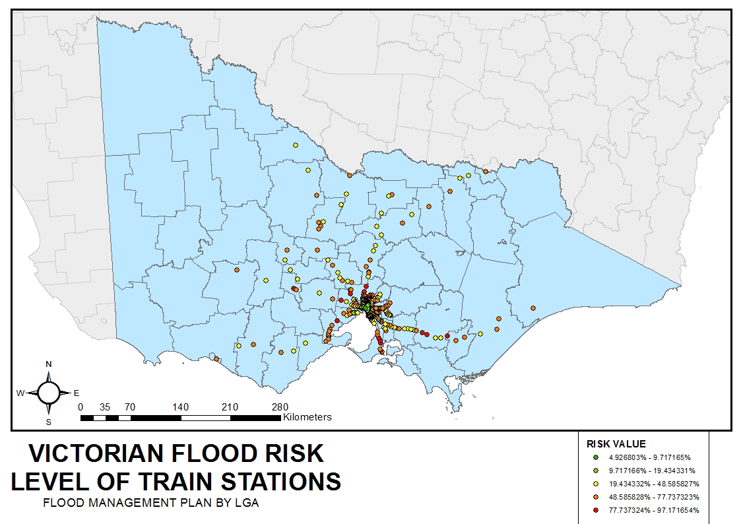
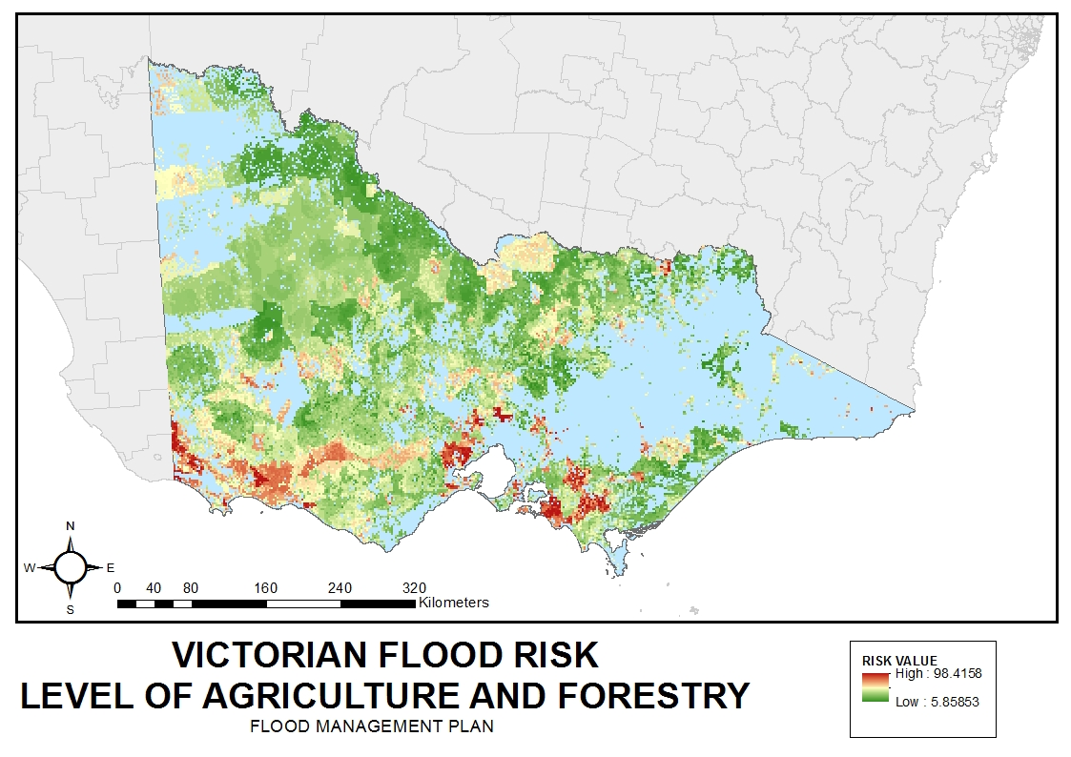
Creating elements at risk layers/ maps
Points
Extract Values to Points tool
Extract the hazard values to your points
Right click data and change symbology to the same as your Hazard/ risk layers
Change symbol if needed
Select properties to change the size of the symbol
Lines
Use the buffer tool to create a buffer around the line
Clip Raster for hazard map to the buffer raster
Change symbology to the same as hazard maps
Polygons
Zonal Statistics Tool = Calculates, Average, Maximum, Minimum raster value for polygon areas, per attribute (e.g. Per SA2 region)
Extract by mask tool = Clips the raster to the polygon area

Slide 8
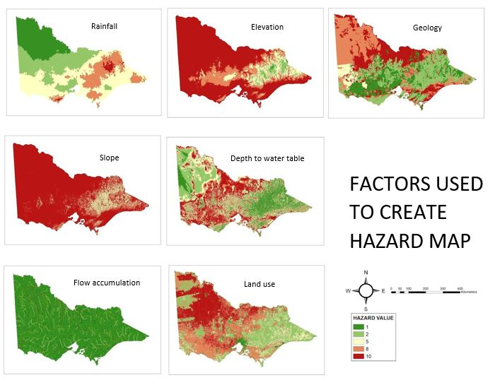
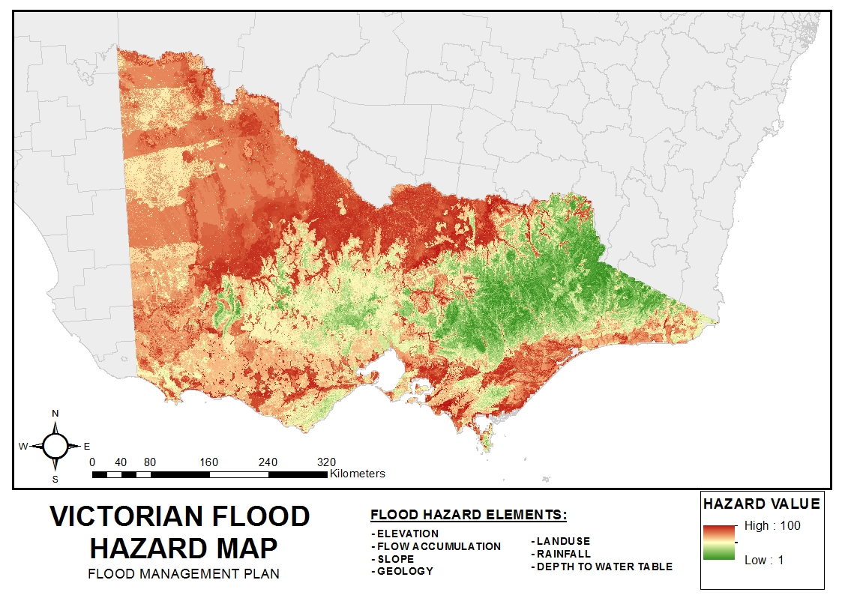
Presentation of your maps

Slide 9
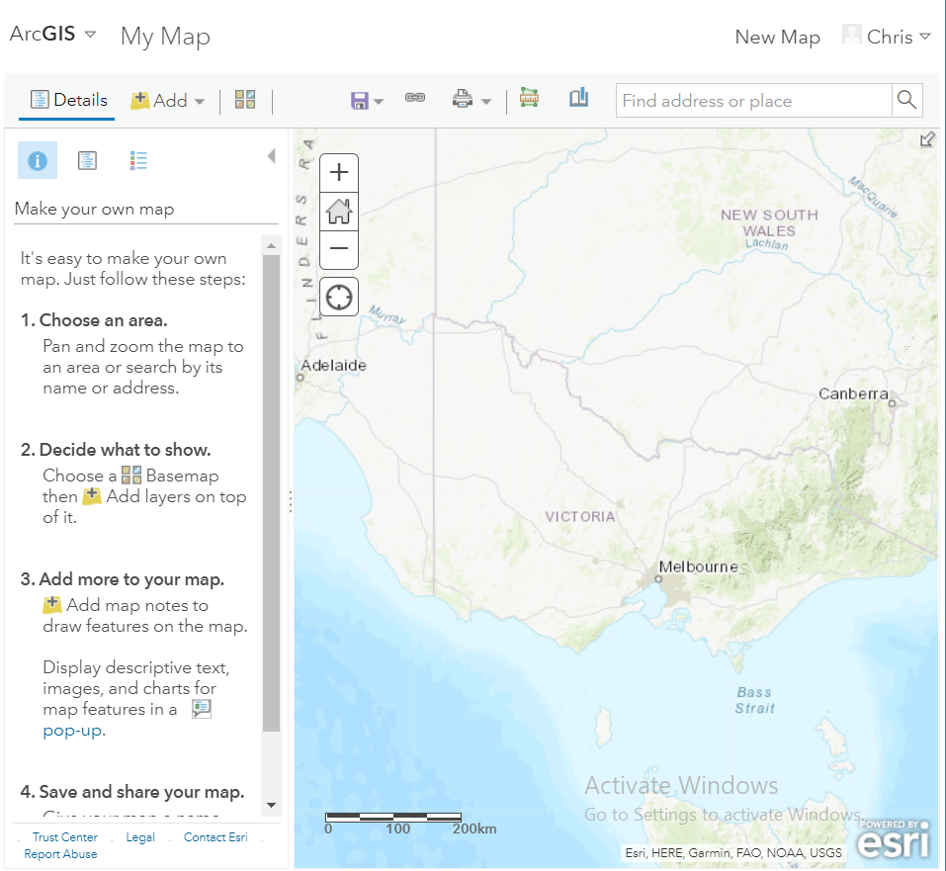
ArcGIS online
Upload TIFs and Shapefiles (must zip all files together beforehand)
Maybe show hazard map and different elements at risk on different layers?
Choose map output style and share URL

